Slide 1
System and Network Security
By
Muwonge S. Bernard, Msc. DCSE
Email: bmuwonge@cit.mak.ac.ug
Tel: +256702-312246
Bernard Muwonge Ssajjabbi, Msc. DCSE
MCN 7103: System and Network Security

Slide 2
Course content
Introduction to computer and network security:
  threats, attacks techniques, vulnerability sources and classification, social and ethical issues.
Host security:
  virus, worms, zombies, etc.
Cryptography:
  Privacy and authentication techniques/protocols and systems.
Basic Firewalls:
  concept, filtering, stateful vs. stateless, FW proxy and design issues.
Notes:
CS 543 - Data Warehousing (Sp 2005-2006) - Asim Karim @ LUMS

Slide 3
Course content
Advanced Firewall Issues:
  policy management (anomaly discovery), distributed firewall, firewall performance, defense-in-depth
IPSec/VPN and NAT:
  network design and policy definition and verification.
Intrusion Detection Concepts , Intrusion Detection Systems.
Server security, SSL
Notes:
CS 543 - Data Warehousing (Sp 2005-2006) - Asim Karim @ LUMS

Slide 4
INTRODUCTION
Information Security requirements have changed in recent times
traditionally provided by physical and administrative mechanisms
computer use requires automated tools to protect files and other stored information
use of networks and communications links requires measures to protect data during transmission
Bernard Muwonge Ssajjabbi, Msc. DCSE
MCN 7103: System and Network Security

Slide 5
Definitions
Computer Security
  generic name for the collection of tools designed to protect data and to prevent hackers
Network Security
  measures to protect data during transmission
Internet Security
  measures to protect data during transmission over a collection of interconnected networks.
Bernard Muwonge Ssajjabbi, Msc. DCSE
MCN 7103: System and Network Security
Notes:
CS 543 - Data Warehousing (Sp 2005-2006) - Asim Karim @ LUMS

Slide 6
Internet Security
Consists of measures to deter, prevent, detect, and correct security violations that involve the transmission & storage of information
Bernard Muwonge Ssajjabbi, Msc. DCSE
MCN 7103: System and Network Security

Slide 7
Examples of Security Violations
User A transmits a file to user B.
    The file contains sensitive information (e.g. payroll records) that is to be protected from disclosure.
    User C, who is not authorized to read the file, is able to monitor the transmission and captures a copy of the file during its transmission.
A message is sent from a customer to a stockbroker with instructions for various transactions. Subsequently, the investments lose value and the customer denies sending the message.
Bernard Muwonge Ssajjabbi, Msc. DCSE
MCN 7103: System and Network Security

Slide 8
Examples cont’d…
A network management application, D, transmits a message to a computer, E, under its management.
  The message instructs computer E to update an authorization file to include the identities of a number of new users who are to be given access to that computer.
  User F intercepts the message, alters its contents to add or delete entries, and then forwards the message to E, which accepts the message as coming from the manager D and updates its authorization file accordingly.
Bernard Muwonge Ssajjabbi, Msc. DCSE
MCN 7103: System and Network Security

Slide 9
Examples cont’d…
An employee is fired without warning.
  The personnel manager sends a message to a server system to invalidate the employee’s account.
  When the invalidation is accomplished, the server is to post a notice to the employee’s file as confirmation of the action. The employee is able to intercept the message and delay it long enough to make a final access to the server to retrieve sensitive information.
  The message is then forwarded, the action is taken, and the confirmation posted. The employee’s action may go unnoticed for some considerable time.
Bernard Muwonge Ssajjabbi, Msc. DCSE
MCN 7103: System and Network Security

Slide 10
Attacks, Services, and Mechanisms
Security Attack:
  Any action that compromises the security of information owned by an organization.
Security Mechanism:
  A mechanism that is designed to detect, prevent, or recover from a security attack.
Security Service:
  A service that enhances the security of data processing systems and information transfers of an organization.
  A security service makes use of one or more security mechanisms.
Bernard Muwonge Ssajjabbi, Msc. DCSE
MCN 7103: System and Network Security

Slide 11
Attacks, Services, and Mechanisms
The terms threat and attack are commonly used to mean more or less the same thing.
Threat: A potential for violation of security, which exists when there is a circumstance, capability, action, or event that could breach security and cause harm.
Attack: An assault on system security that derives from an intelligent threat, that is an intelligent act that is deliberate attempt to evade security services and violate the security policy of the system.
Bernard Muwonge Ssajjabbi, Msc. DCSE
MCN 7103: System and Network Security

Slide 12
Security Attack
Any action that compromises the security of information owned by an organization
Information security is about how to prevent attacks; to detect attacks on information-based systems
often threat & attack used to mean same thing
have a wide range of attacks
Focus is on two generic types of attacks
  passive
  active
Bernard Muwonge Ssajjabbi, Msc. DCSE
MCN 7103: System and Network Security
Notes:
Expand on definition and use of “security attack”, as detailed above.
See Stallings Table 1.1 for definitions of threat and attack.

Slide 13
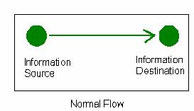
Security Attacks
Attacks on the security of a computer system or network are best characterized by viewing the function of the computer system as providing information.
In general there is a flow of information from a source, such as a file , to a destination, such as a hard disk.
Bernard Muwonge Ssajjabbi, Msc. DCSE
MCN 7103: System and Network Security

Slide 14
Passive Attacks
Passive attacks are in the nature of eavesdropping on, or monitoring of, transmissions.
The goal of the opponent is to obtain information that is being transmitted.
There are two major types of passive attacks:
  (1) release of message contents and
  (2) traffic analysis.
    Examples(traffic analysis): Creating a customer profile of a user by using information about the sites that he or she visits.
Bernard Muwonge Ssajjabbi, Msc. DCSE
MCN 7103: System and Network Security

Slide 15

Passive Attacks
Reading content of messages - Eavesdropping
Observing traffic flow-Traffic Analysis
Packet sniffing
Difficult to detect passive attacks
Defence: to prevent their success
Bernard Muwonge Ssajjabbi, Msc. DCSE
MCN 7103: System and Network Security

Slide 16

Passive Attacks
  Release of message content is concerned with obtaining the sensitive or confidential contents of a transferred file or e-mail.
  Traffic analysis threat is more delicate and is concerned with masking the contents of transmitted files so that even if they were captured, it would not be possible to extract the sensitive information.
    The most common technique for masking contents is encryption.
continued
Bernard Muwonge Ssajjabbi, Msc. DCSE
MCN 7103: System and Network Security

Slide 17
Traffic Analysis
Wireless foot printing - which is the first step to any type of hacking is done by carrying out traffic analysis.
Attackers before mounting an active attack have to obtain sufficient information about the network.
This operation of traffic analysis gives the attacker some basic information about the network, like the network activity going on, network protocols and network access points.
Bernard Muwonge Ssajjabbi, Msc. DCSE
MCN 7103: System and Network Security

Slide 18
Passive Eavesdropping
This attack is very similar to traffic analysis.
Also discloses the information about the network but at the same time the attacker can access and read the message content.
If the message is encrypted, the attacker will need to break the encryption and read the message.
This will lead to compromise of information and privacy as the attacker will:
    read the data transmitted in session and
    get information about packet characteristics.
Bernard Muwonge Ssajjabbi, Msc. DCSE
MCN 7103: System and Network Security

Slide 19
Packet Sniffing
“A sniffer is an application or device that can read, monitor, and capture network data exchanges and read network packets”.
Some consider sniffing as the most common type of passive attack on networks.
A sniffer can provide a full view of data inside a packet if the packets are not encrypted.
Sniffing programs come in the form of either commercial packet sniffers used to help maintain networks or underground packet sniffers used to break into computers.
Bernard Muwonge Ssajjabbi, Msc. DCSE
MCN 7103: System and Network Security

Slide 20
Packet sniffing
An attacker using a sniffer can read a network’s communications and analyze it to gain information to eventually cause the network to crash or even become corrupted.
Vulnerable protocols that are often sniffed, especially for passwords, include telnet, ftp, rlogin, IMAP, and POP.
continued
Bernard Muwonge Ssajjabbi, Msc. DCSE
MCN 7103: System and Network Security

Slide 21
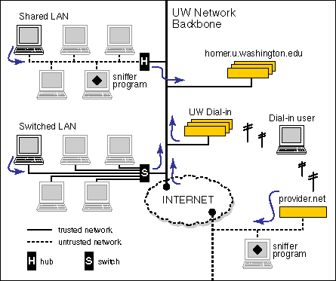
Sniffing attack
The diagram below demonstrates a passive sniffing attack at the University of Washington
Bernard Muwonge Ssajjabbi, Msc. DCSE
MCN 7103: System and Network Security

Slide 22
Passive Attack detection
  Passive attacks are very difficult to detect because they do not involve any alteration of the data.
    However, it is possible to greatly limit the success of these attacks.
    Consequently, the emphasis on counteracting passive attacks is on prevention rather than on detection.
    Encryption has been one of the most common methods for preventing passive attacks.
Bernard Muwonge Ssajjabbi, Msc. DCSE
MCN 7103: System and Network Security

Slide 23
Active Attacks
These involve some modification of the data stream or the creation of a false stream.
Categories: masquerade, replay, modification of messages, Denial of Service, Man-in-the-middle.
  A masquerade takes place when one entity pretends to be a different entity.
  Replay involves the passive capture of a data unit and its subsequent retransmission to produce an unauthorized effect.
  Modification of messages simply means that some portion of a legitimate message is altered, or that messages are delayed or reordered, to produce an unauthorized effect.
  Denial of Service prevents or inhibits the normal use or management of communications facilities.
Bernard Muwonge Ssajjabbi, Msc. DCSE
MCN 7103: System and Network Security

Slide 24

Active Attacks
Bernard Muwonge Ssajjabbi, Msc. DCSE
MCN 7103: System and Network Security
Notes:
Also have “active attacks” which attempt to alter system resources or affect their operation.
By modification of data stream to:
+ masquerade of one entity as some other
+ replay previous messages (as shown above in Stallings Figure 1.4b)
+ modify messages in transit
+ denial of service
Active attacks present the opposite characteristics of passive attacks. Whereas passive attacks are difficult to detect, measures are available to prevent their success. On the other hand, it is quite difficult to prevent active attacks absolutely, because of the wide variety of potential physical,software,and network vulnerabilities. Instead, the goal is to detect active attacks and to recover from any disruption or delays caused by them.

Slide 25
Man-In-the-Middle Attack
Attacks data confidentiality
It compromises the integrity of messages as they can be read and/or modified by the attacker.
Attacker fools both participants of the connection and all data is passed through him.
Bernard Muwonge Ssajjabbi, Msc. DCSE
MCN 7103: System and Network Security

Slide 26
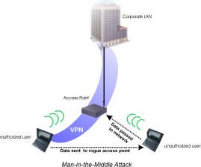

Man-in-the-middle attack
Bernard Muwonge Ssajjabbi, Msc. DCSE
MCN 7103: System and Network Security

Slide 27
Session Hijacking
Involves taking control of the session.
Victim thinks session is no longer in operation
Attacker can exploit the session for many purposes.
Basically done by exploiting the MAC of the Access Point - AP and the victim
After the victim is authenticated by the AP, the attacker impersonates as the AP by using its MAC and sends a MAC –Disassociate message to the victim.
The victim then closes the session but the real AP has the session open
The attacker then acts as the victim by using its MAC and gains control over the session.
This attack happens in real time and also compromises the integrity aspect.
Bernard Muwonge Ssajjabbi, Msc. DCSE
MCN 7103: System and Network Security

Slide 28
Replay
Happens offline, rather than in real time
The attacker can capture data of a session and can use it later to exploit the victim’s information.
This could be the user’s authentication info.
These can be avoided by introducing timeouts in a message
Bernard Muwonge Ssajjabbi, Msc. DCSE
MCN 7103: System and Network Security

Slide 29
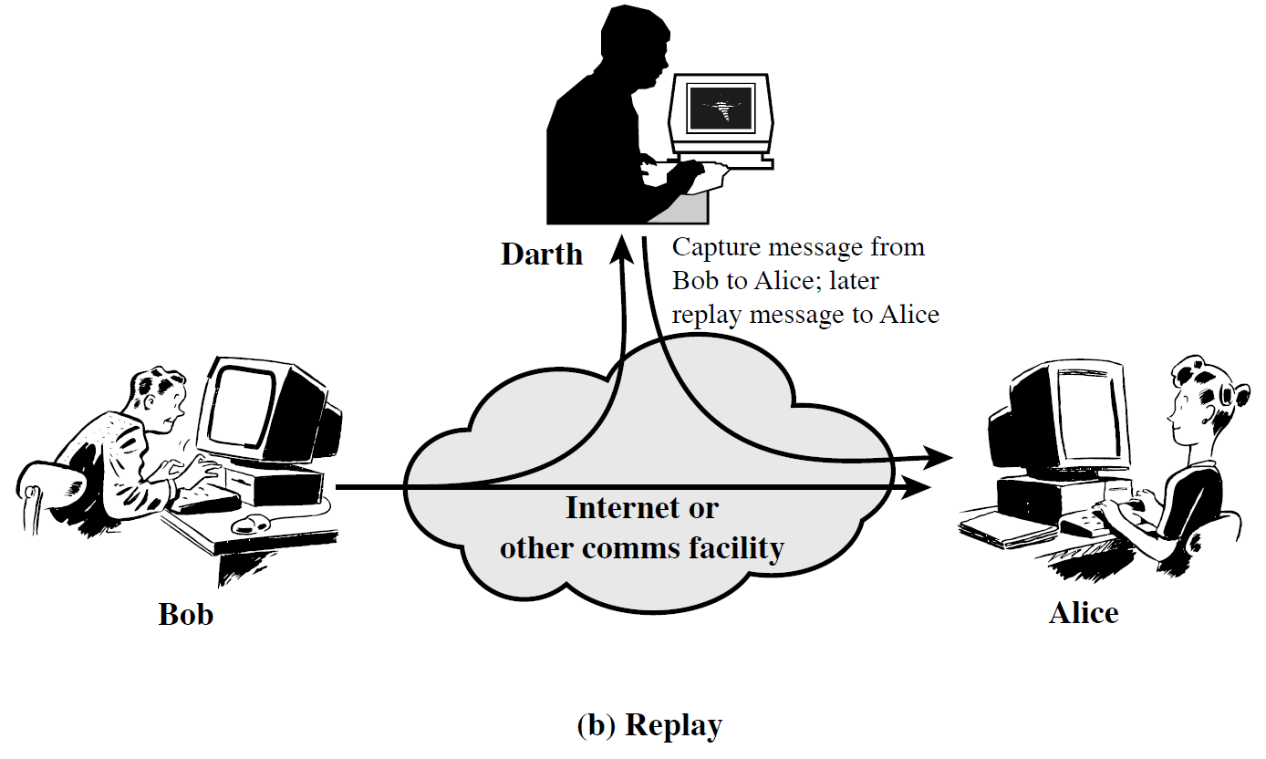
Replay attack
.
continued
Bernard Muwonge Ssajjabbi, Msc. DCSE
MCN 7103: System and Network Security

Slide 30
Denial of Service - DoS
Aims at bringing down the system so that it does not respond to the user’s request.
This is done by sending very huge volumes of traffic at the victim machine making it unable to respond.
It thus deals with the attacker trying to keep the user from accessing the system resources.
More advanced forms of DoS attacks are DDoS attacks and DRDoS
Bernard Muwonge Ssajjabbi, Msc. DCSE
MCN 7103: System and Network Security

Slide 31
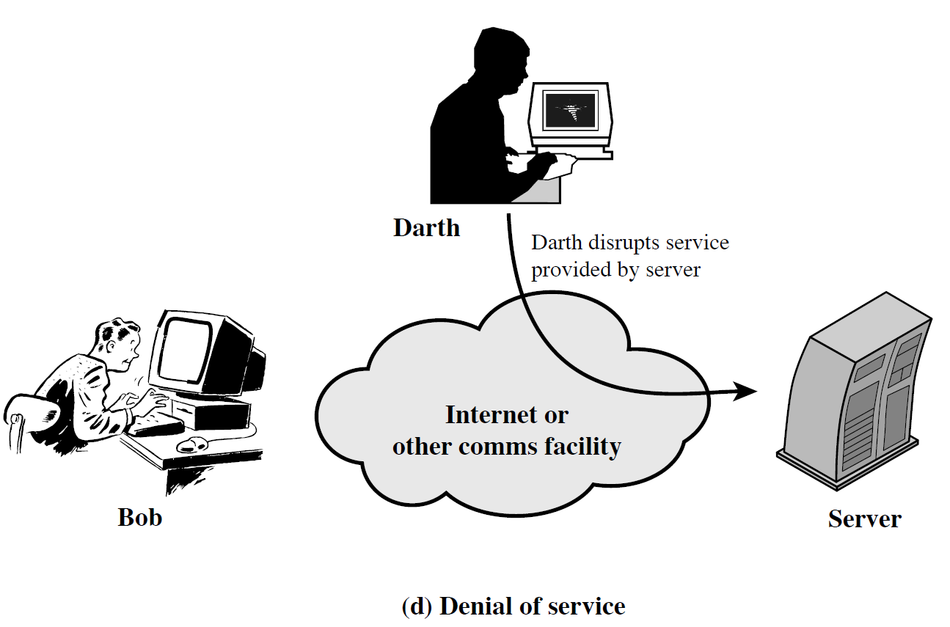
DoS Attack
Bernard Muwonge Ssajjabbi, Msc. DCSE
MCN 7103: System and Network Security

Slide 32
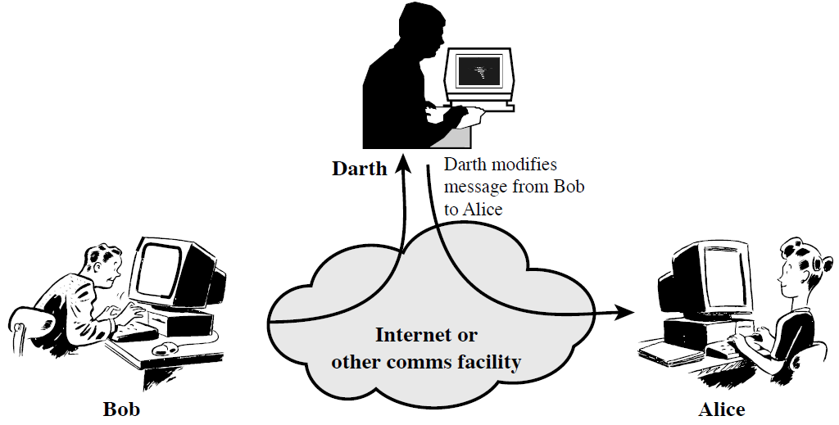
Modification of messages
A portion of legitimate message is altered, or
Messages are delayed or reordered, to produce an unauthorized effect.
Bernard Muwonge Ssajjabbi, Msc. DCSE
MCN 7103: System and Network Security

Slide 33
Masquerade attack
One entity pretends to be a different entity.
Usually includes one of the other forms of active attack.
    Authentication sequences can, say, be captured and replayed after a valid authentication sequence has taken place,
    This, thus enables an authorized entity with few privileges to obtain extra privileges by impersonating an entity that has those privileges.
Bernard Muwonge Ssajjabbi, Msc. DCSE
MCN 7103: System and Network Security

Slide 34

Masquerade attack
continued
Bernard Muwonge Ssajjabbi, Msc. DCSE
MCN 7103: System and Network Security

Slide 35
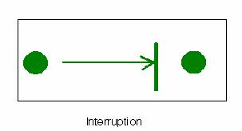
Security Attacks…
Interruption: An asset of the system is destroyed or becomes unavailable or unusable.”This is an attack on availability.”
Example:
  Destruction of a piece of hardware, such as a hard disk,
  Cutting of a communication line,
  Disabling of a file management system.
Bernard Muwonge Ssajjabbi, Msc. DCSE
MCN 7103: System and Network Security

Slide 36
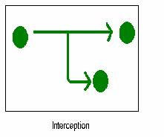
Interception
An unauthorized user gains access to an asset. “This is an attack on confidentiality.” The unauthorized user may be a person, computer or program.
Examples:
  Wiretapping to capture data in a network
  Unauthorized copying of files or programs.
Bernard Muwonge Ssajjabbi, Msc. DCSE
MCN 7103: System and Network Security

Slide 37
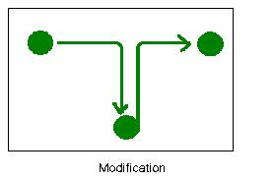
Modification
An unauthorized user not only gains access to but tampers with an asset.
“This is an attack on integrity.”
Examples:
  Changing data in a data file,
  altering a program so that it performs differently,
  modifying the content of messages being transmitted on a network.
Bernard Muwonge Ssajjabbi, Msc. DCSE
MCN 7103: System and Network Security

Slide 38
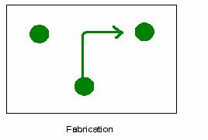
Fabrication
An unauthorized user (party) inserts counterfeit objects into the system.
“This an attack on authenticity.”
Examples:
  Insertion of spurious messages in a network
  Addition of records to a file.
Bernard Muwonge Ssajjabbi, Msc. DCSE
MCN 7103: System and Network Security

Slide 39
Security Services (X.800)
Authentication
    assurance that the communicating entity is the one claimed
Access Control
    prevention of the unauthorized use of a resource
Data Confidentiality
    protection of data from unauthorized disclosure
Data Integrity
    assurance that data received is as sent by an authorized entity
Non-Repudiation
    protection against denial by one of the parties in a communication
Bernard Muwonge Ssajjabbi, Msc. DCSE
MCN 7103: System and Network Security
Notes:
This list includes the various "classic" security services which are traditionally discussed.
Note there is a degree of ambiguity as to the meaning of these terms, and overlap in their use.
See Stallings Table 1.2 for details of the 5 Security Service categories and the 14 specific services given in X.800.

Slide 40
Others…
Availability
    This service is concerned with assuring the permanence of a service or data for authorized users
        The Denial of Service Attack prevents or inhibits the normal use or management of communication facilities.
        Virus that deletes files
Bernard Muwonge Ssajjabbi, Msc. DCSE
MCN 7103: System and Network Security

Slide 41
Security Mechanism
Feature designed to detect, prevent, or recover from a security attack
No single mechanism that will support all services required
however one particular element underlies many of the security mechanisms in use:
    cryptographic techniques
Bernard Muwonge Ssajjabbi, Msc. DCSE
MCN 7103: System and Network Security
Notes:
Now introduce “Security Mechanism” which are the specific means of implementing one or more security services.
Note these mechanisms span a wide range of technical components, but one aspect seen in many is the use of cryptographic techniques.

Slide 42
Security Mechanisms (X.800)
specific security mechanisms:
    Encipherment, digital signatures, access controls, data integrity, authentication exchange, traffic padding, routing control, notarization
pervasive security mechanisms:
    trusted functionality, security labels, event detection, security audit trails, security recovery
Bernard Muwonge Ssajjabbi, Msc. DCSE
MCN 7103: System and Network Security
Notes:
Some examples of mechanisms from X.800. Note that the “specific security mechanisms” are protocol layer specific, whilst the “pervasive security mechanisms” are not. We will meet some of these mechanisms in much greater detail later.
See Stallings Table 1.3 for details of these mechanisms in X.800, and Table 1.4 for the relationship between services and mechanisms.

Slide 43
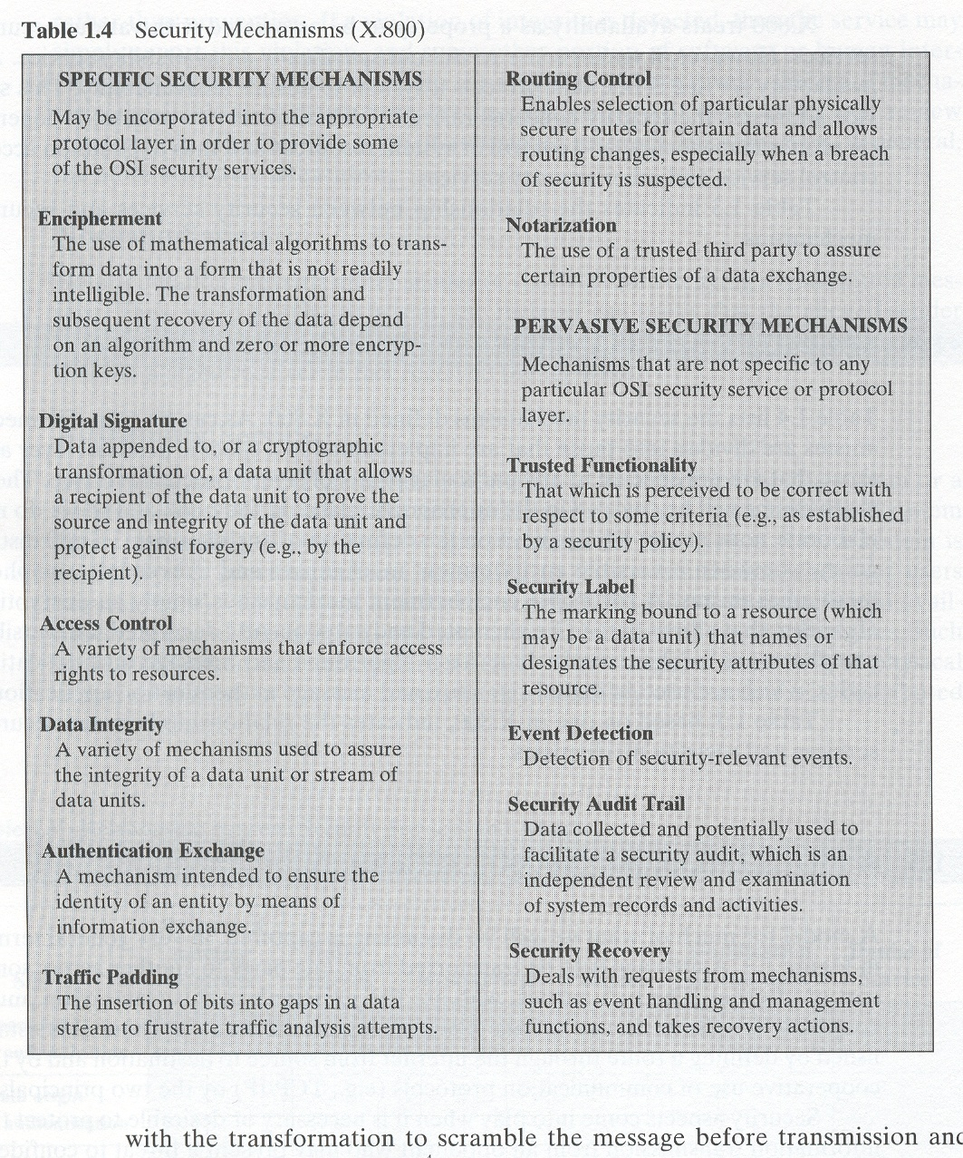
Security mechanisms(X.800)
Mechanisms
Bernard Muwonge Ssajjabbi, Msc. DCSE
MCN 7103: System and Network Security

Slide 44

Q & A
“In life, always expect questions, but do not expect answers”
Bernard Muwonge Ssajjabbi, Msc. DCSE
MCN 7103: System and Network Security

